Slide 1
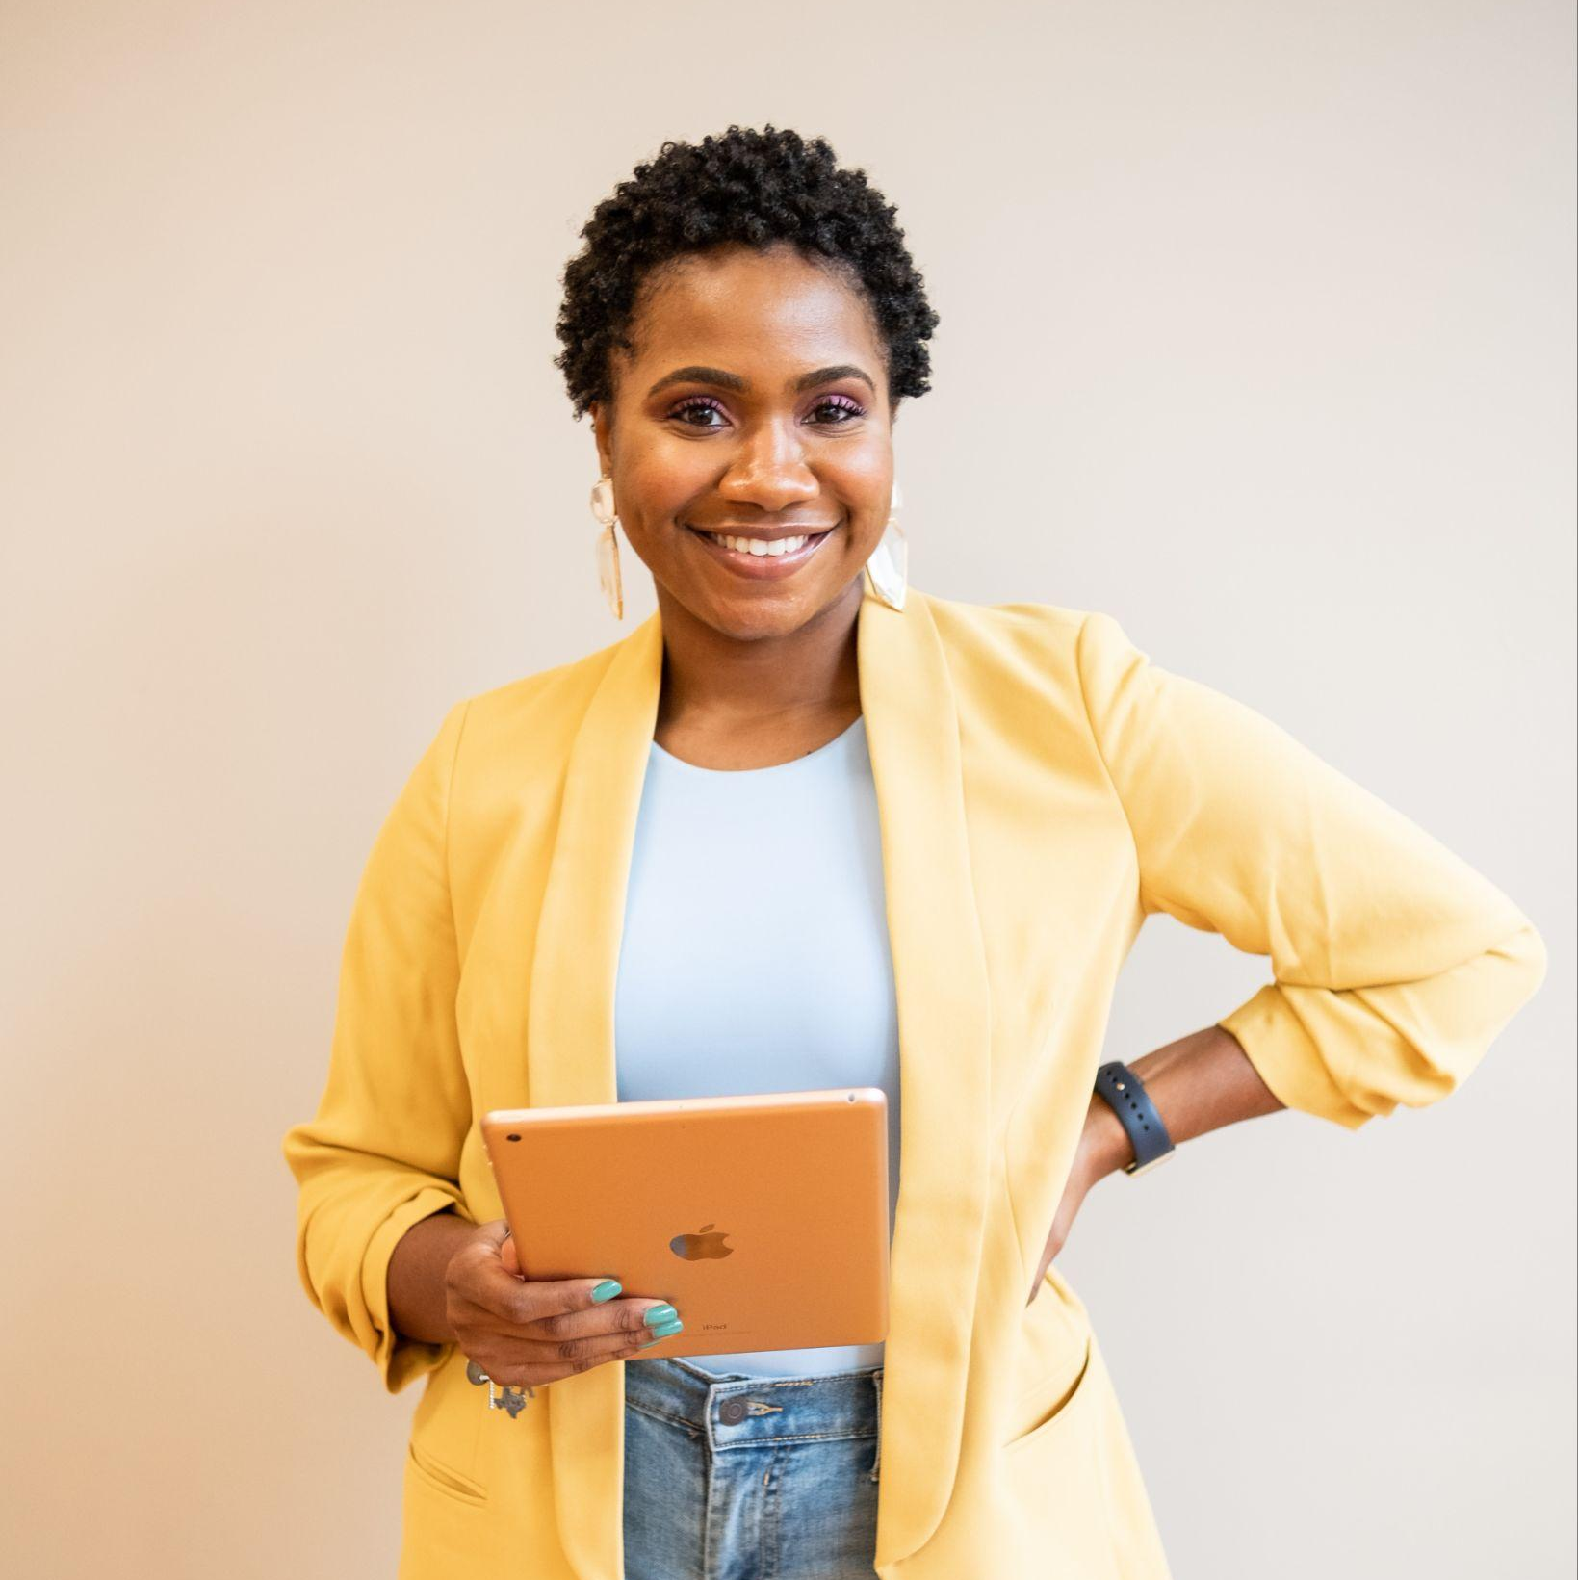
Biography:
Personality:
Hobbies
Favorite brands:
Motivations (to acquire your service/product):
Frictions (to acquire your service/product):
Gets information from (include media, social networks, etc)
[Picture/Avatar]
Name: Olivia
Gender: Female
Age: 35
Job: Head of Marketing
Industry: SaaS
Level of studies: MBA
City: New York

Slide 2
Biography:
Personality:
Hobbies
Favorite brands:
Motivations (to acquire your service/product):
Frictions (to acquire your service/product):
Gets information from (include media, social networks, etc)
[Picture/Avatar]
Name:
Gender:
Age:
Job:
Industry:
Level of studies:
City:

